Slide 1


How To Improve the Model

Slide 2
Scope of Improvement
More data may be required
Data needs to have more diversity
Algorithm needs longer training
More hidden layers or hidden units are required
Add Regularization
Change the Neural network architecture like activation function etc.
There are many other considerations you can think of.

Slide 3
Dataset Splitting
Training set
Which you run your learning algorithm on.
Dev (development) set or Validation Set
Which you use to tune parameters, select features, and make other decisions regarding the learning algorithm. Sometimes also called the hold-out cross validation set .
Test set
which you use to evaluate the performance of the algorithm, but not to make any decisions regarding what learning algorithm or parameters to use.

Slide 4
Dataset Splitting
Training Set | Dev Test or Hold Out Cross Validation Set | Test Set
Traditional Style partitioning 70/30 or 60/20/20
But in the era of Deep Learning may even go down to 99 0.5 0.5
If the data size is 1,00,0000 then 5000 5000 data size will still be there in dev and test sets

Slide 5
Val & Test Set
The purpose of the dev and test sets are to direct your team toward the most important changes to make to the machine learning system
Very important that dev and test set reflect data you expect to get in the future
Bad distribution will severely restrict analysis to guess that why test data is not giving good results
It is naturally good to have the data in all the sets from the same distribution.
For example Housing data coming from Mumbai and we are trying to find the house prices in Chandigarh.
Else wasting a lot of time in improving the performance of dev set and then finding out that it is not working well for the test set.

Slide 6
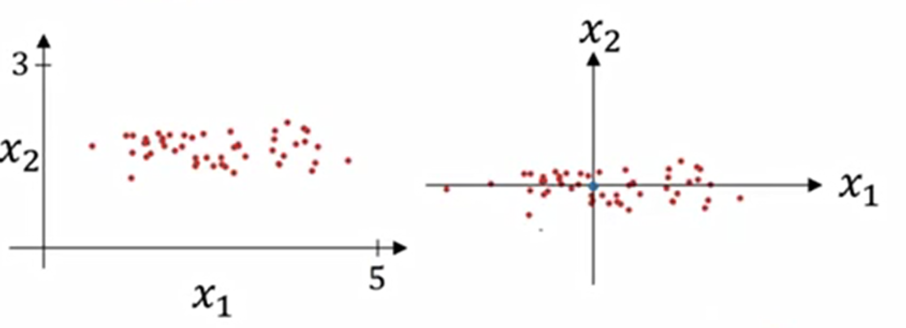
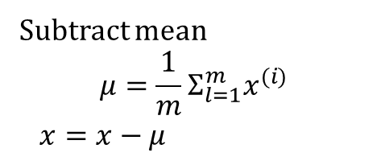
Normalizing Data Sets
Subtract mean
$$μ=\frac{1}{m}Σ_{l=1}^{m}x^{(i)}$$
$x=x−μ$
Original data

Slide 7
Normalization
Stabilizes Training:
Stabilizing the gradient descent & ensures gradients do not become too large or too small.
In deep networks where small changes in input can lead to large changes in output.
Speeds Up Convergence:
Model may converge faster.
Optimizer can navigate the loss landscape more efficiently when the features are on a similar scale

Slide 8
Batch GD, Mini-Batch GD & Stochastic GD
Aspect | Batch Gradient Descent | Mini-Batch Gradient Descent | Stochastic Gradient Descent (SGD)
Definition | Uses the entire training dataset to compute the gradient and update the model parameters. | Uses a subset of the training data (mini-batch) to compute the gradient and update the model parameters. | Uses a single training example to compute the gradient and update the model parameters.
Pros | - Stable and accurate estimate of the gradient. | Balances stability and speed Allows for more frequent updates Can lead to faster convergence. | Very fast updates Can handle large datasets efficiently Introduces noise that can help escape local minima.
Cons | - Slow and computationally expensive with large datasets. | Choice of mini-batch size affects performance Too small: noisy updates Too large: slow training. | High variance in updates can lead to noisy gradients May require more iterations to converge.
Update Frequency | Once per epoch (entire dataset). | Multiple times per epoch (based on mini-batch size). | Once per training example.
Memory Usage | High, as it requires loading the entire dataset into memory. | Lower, as only a subset of the data is loaded at a time. | Very low, as only one training example is loaded at a time.
Convergence | Can be slow due to the large amount of data processed at once. | Typically faster due to more frequent updates. | Can be very fast but may be noisy and require more iterations.

Slide 9
Regularization

Slide 10
Why
Model learns to perform extremely well on training data but fails to generalize to new, unseen data (Test Data)
Overfitting happens when the model is too complex, allowing it to capture noise and irrelevant patterns in the training data.
Regularization is a technique used to prevent overfitting by adding a penalty to the model’s complexity.
Helps models generalize better to new, unseen data.

Slide 11
Why
Underfit
High Bias
Balanced
Overfit
High Variance
High Bias – Underfit (Training error is high). Model is too simple to capture the patterns in the data
High Variance – Overfit (Model fails on test/unseen data)

Slide 12
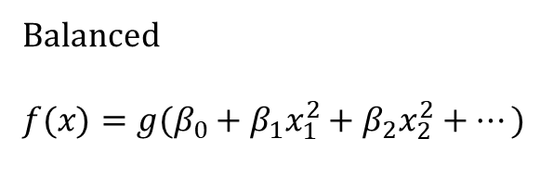
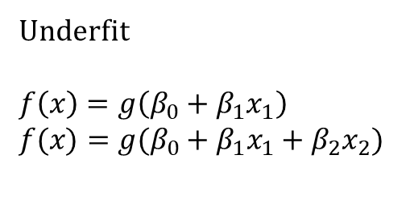
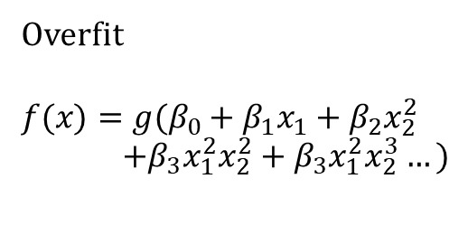
Why
Underfit
$$f\left(x\right)=g\left(β_{0}+β_{1}x_{1}\right)$$
$$f(x)=g(β_{0}+β_{1}x_{1}+β_{2}x_{2})$$
Balanced
$$f(x)=g(β_{0}+β_{1}x_{1}^{2}+β_{2}x_{2}^{2}+…)$$
Overfit
$$f(x)=g(β_{0}+β_{1}x_{1}+β_{2}x_{2}^{2}$$
$+β_{3}x_{1}^{2}x_{2}^{2}+β_{3}x_{1}^{2}x_{2}^{3}…)$

Slide 13
When
Overfitting: High training accuracy but low validation accuracy.
High Model Complexity: Learn complex patterns, including noise in the training data.
Small or Noisy Dataset: If the dataset is small or contains a significant amount of noise, the model might overfit, learning patterns that do not generalize well to new data.
Insufficient Variety: Lack the diversity, full range of possible inputs
Poor Generalization: Pick up on irrelevant features.
Multicollinearity: When features are highly correlated.
Complex Models: When using models with many parameters or features.

Slide 14
How
Penalty Term: Added to the loss function to discourage large coefficients.
Loss Function: Regularization = Loss Function + Penalty
Objective: Minimize the loss function while keeping the model simple.

Slide 15
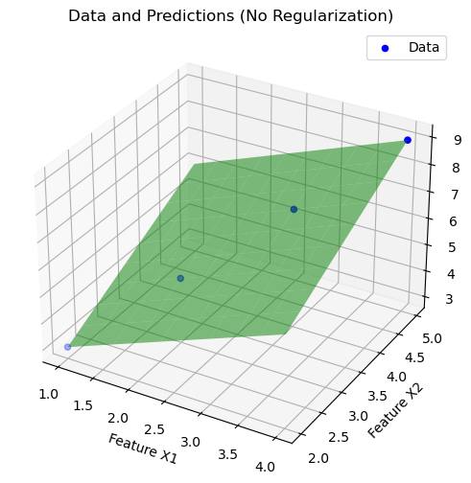
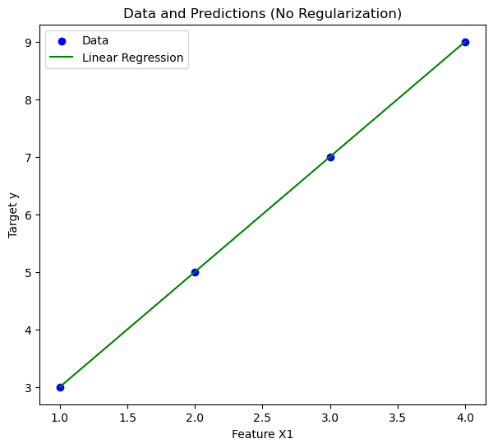

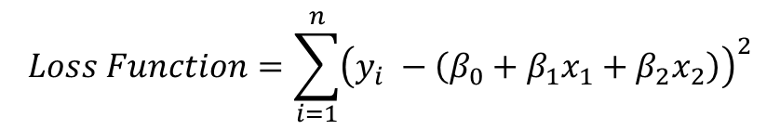

Without Regularization
( x_1 ) | ( x_2 ) | ( y )
1 | 2 | 3
2 | 3 | 5
3 | 4 | 7
4 | 5 | 9
$$\hat{y}=β_{0}+β_{1}x_{1}+β_{2}x_{2}$$
$$Loss Function=\sum_{i=1}^{n}{{\left(y_{i} −\left(β_{0}+β_{1}x_{1}+β_{2}x_{2}\right)\right)}^{2}}$$
$$\hat{y}=1+x_{1}+x_{2}$$

Slide 16
Types of Regularization
L1 Regularization (Lasso)
L2 Regularization (Ridge)
Dropout
Early Stopping
Data Augmentation

Slide 17
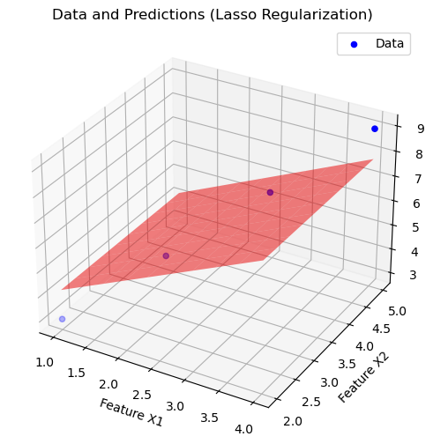

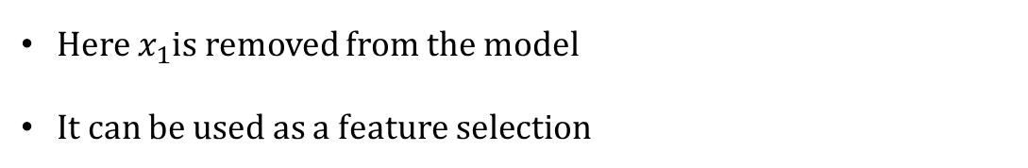
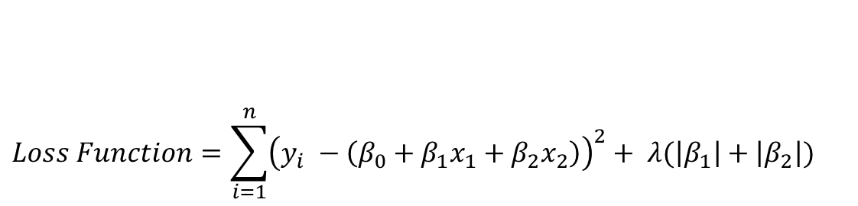

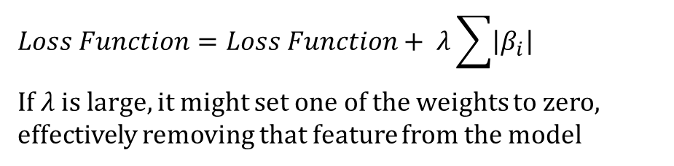
L1 Regularization (Lasso)
( x_1 ) | ( x_2 ) | ( y )
1 | 2 | 3
2 | 3 | 5
3 | 4 | 7
4 | 5 | 9
Adds the absolute value of the coefficients as a penalty term to the loss function
$$\hat{y}=β_{0}+β_{1}x_{1}+β_{2}x_{2}$$
$$Loss Function=Loss Function+ λ\sum{\left|β_{i}\right|}$$
If $λ$ is large, it might set one of the weights to zero, effectively removing that feature from the model
$$Loss Function=\sum_{i=1}^{n}{{\left(y_{i} −\left(β_{0}+β_{1}x_{1}+β_{2}x_{2}\right)\right)}^{2}}+ λ(\left|β_{1}\right|+\left|β_{2}\right|)$$
$$\hat{y}=1+{0.x}_{1}+x_{2}$$
Here $x_{1}$is removed from the model
It can be used as a feature selection

Slide 18
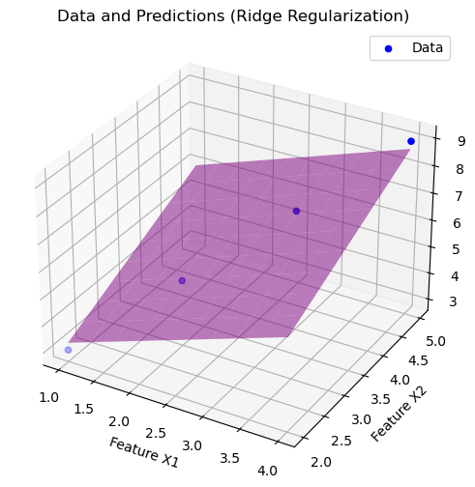


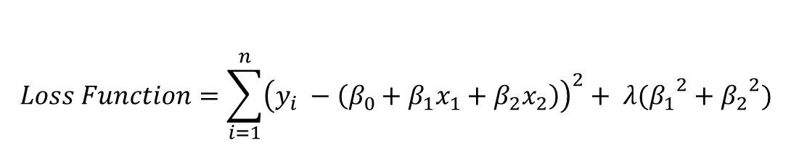
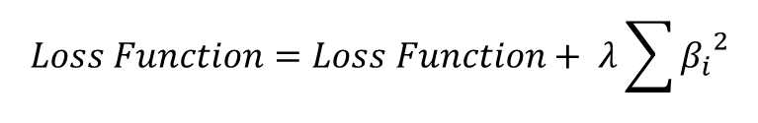
L2 Regularization (Ridge)
( x_1 ) | ( x_2 ) | ( y )
1 | 2 | 3
2 | 3 | 5
3 | 4 | 7
4 | 5 | 9
Adds the squared value of the coefficients as a penalty term to the loss function.
It tends to shrink the coefficients but does not set any of them to zero
$$\hat{y}=β_{0}+β_{1}x_{1}+β_{2}x_{2}$$
$$Loss Function=Loss Function+ λ\sum{{β_{i}}^{2}}$$
$$Loss Function=\sum_{i=1}^{n}{{\left(y_{i} −\left(β_{0}+β_{1}x_{1}+β_{2}x_{2}\right)\right)}^{2}}+ λ({β_{1}}^{2}+{β_{2}}^{2})$$
$$\hat{y}=1+{08.x}_{1}+{0.8x}_{2}$$
The weights are shrunk but not set to zero

Slide 19
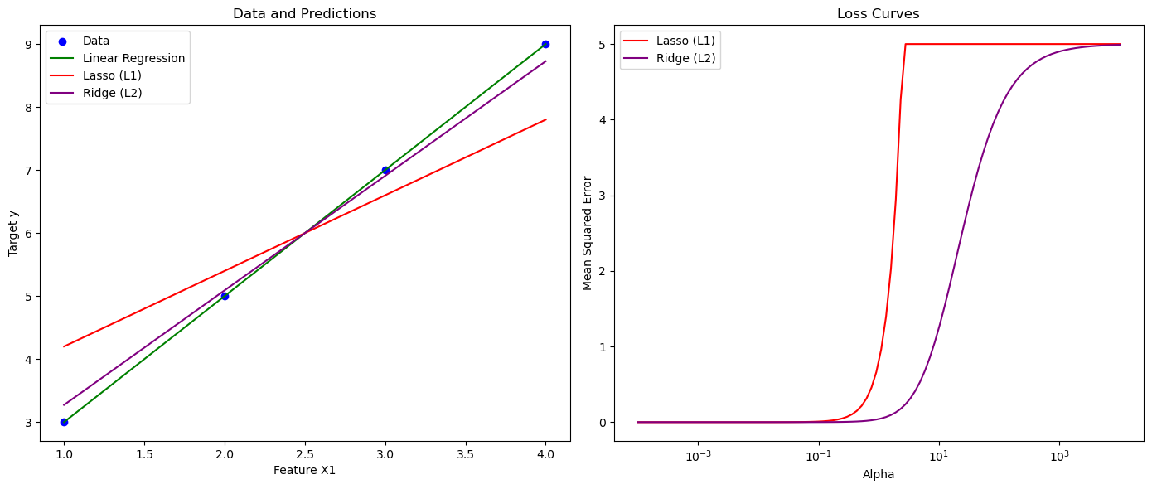
Comparison
( x_1 ) | ( x_2 ) | ( y )
1 | 2 | 3
2 | 3 | 5
3 | 4 | 7
4 | 5 | 9

Slide 20










Dropout
Randomly “dropping out” (i.e., setting to zero) a fraction of the neurons during training
Forces the network to learn more robust features that are not reliant on any single neuron.
Dropout can be different for different layers
Helps in shrinking weights
Finding the optimal dropout rate can be time-consuming and may require extensive experimentation.
Finding the optimal dropout rate can be time-consuming and may require extensive experimentation.
Training may be slow as it needs more epochs to converge
Model may get underfitted if dropout rate is high
$$x_{1}$$
$$x_{1}$$
$$x_{2}$$
$$x_{2}$$
$$\hat{y}$$
$$\hat{y}$$
$$x_{3}$$
$$x_{3}$$
$$x_{4}$$
$$x_{4}$$

Slide 21
Early stopping
Monitors the model’s performance on a validation set during training
Stops the training process when the performance starts to degrade/overfit
Training is stopped when the validation loss stops decreasing and starts to increase, indicating overfitting.
Validation error
Loss
Training error
Epochs

Slide 22
Data Augmentation
Improves generalization ability of the model
Provides variations in the data to the model during the training phase and prevents overfitting
Geometric Transformations: Rotation, translation, scaling, flipping, and cropping.
Color Transformations: Adjusting brightness, contrast, saturation, and hue.
Noise Addition: Adding random noise to the images.
Other Techniques: Random erasing, cutout, mixup, cut mix, etx.

Slide 23
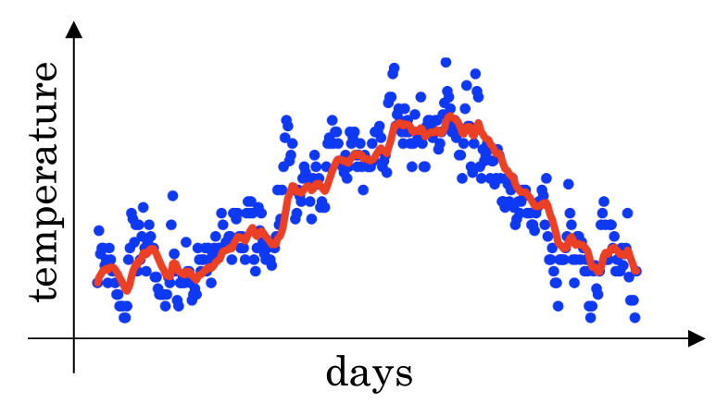
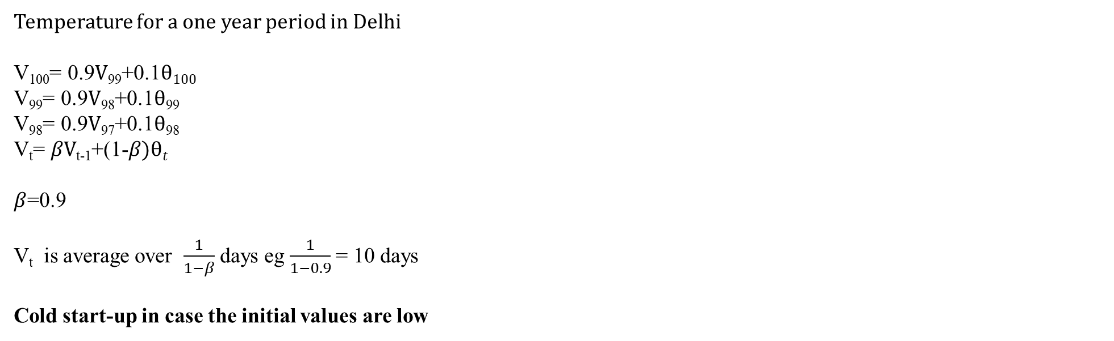
Exponentially weighted averages
Temperature for a one year period in Delhi
V₁₀₀= 0.9$V$₉₉+0.1$θ100$
V₉₉= 0.9$V$₉₈+0.1$θ$₉₉
V₉₈= 0.9$V$₉₇+0.1$θ$₉₈
V_{t}= $βV$_{t-1}+(1-$β)θt$
$β$=0.9
V_{t} is average over $\frac{1}{1−β}$ days eg $\frac{1}{1−0.9}$ = 10 days
Cold start-up in case the initial values are low

Slide 24
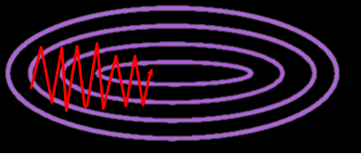
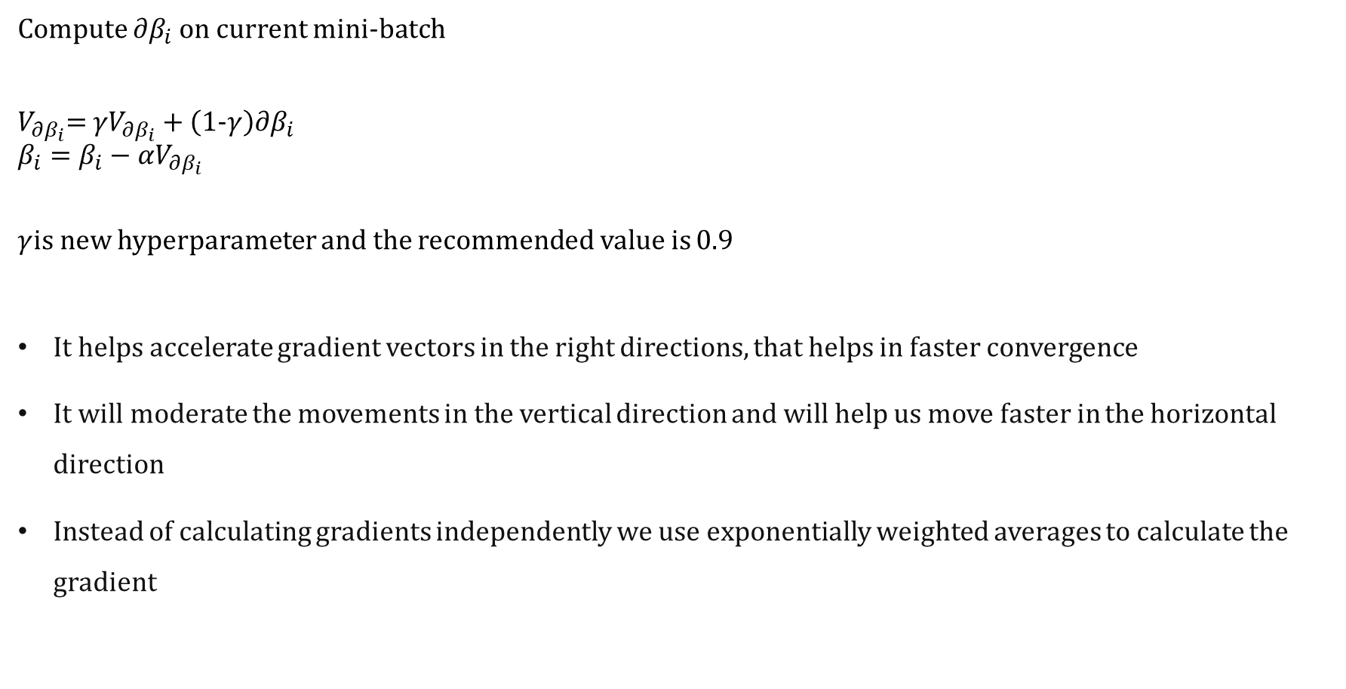
Momentum
Compute $∂β_{i}$ on current mini-batch
$V_{∂β_{i}}$= ${γV}_{∂β_{i}}+\left(\text{1-}γ\right)∂β_{i}$
$$β_{i}=β_{i}−αV_{∂β_{i}}$$
$γ$is new hyperparameter and the recommended value is 0.9
It helps accelerate gradient vectors in the right directions, that helps in faster convergence
It will moderate the movements in the vertical direction and will help us move faster in the horizontal direction
Instead of calculating gradients independently we use exponentially weighted averages to calculate the gradient

Slide 25

RMSProp (Root Mean Square Prop)
Compute $∂β_{i}$on current mini-batch
$$S_{∂β_{i}}= {γS}_{∂β_{i}}+\left(\text{1−}γ\right){∂β_{i}}^{2}$$
$$β_{i}=β_{i}−α\frac{∂β_{i}}{\sqrt{S_{∂β_{i}}}+ ∈}$$
$∈ =$10⁻⁸

Slide 26


Adam optimization Algorithm
Compute $∂β_{i}$on current mini-batch
$$S_{∂β_{i}}= {γ_{1}S}_{∂β_{i}}+\left(\text{1−}γ_{1}\right){∂β_{i}}^{2}$$
$V_{∂β_{i}}$= ${γ_{2}V}_{∂β_{i}}+\left(\text{1−}γ_{2}\right)∂β_{i}$
$$β_{i}=β_{i}−α\frac{V_{∂β_{i}}}{\sqrt{S_{∂β_{i}}}+ ∈}$$
$γ_{1}$=0.9 ($∂β_{i}$) also referred to as moment 1
$γ_{2}$=0.999 (${∂β_{i}}^{2}$) also referred to as moment 2 $∈$ = 10⁻⁸
Adaptive Moment estimation

Slide 27
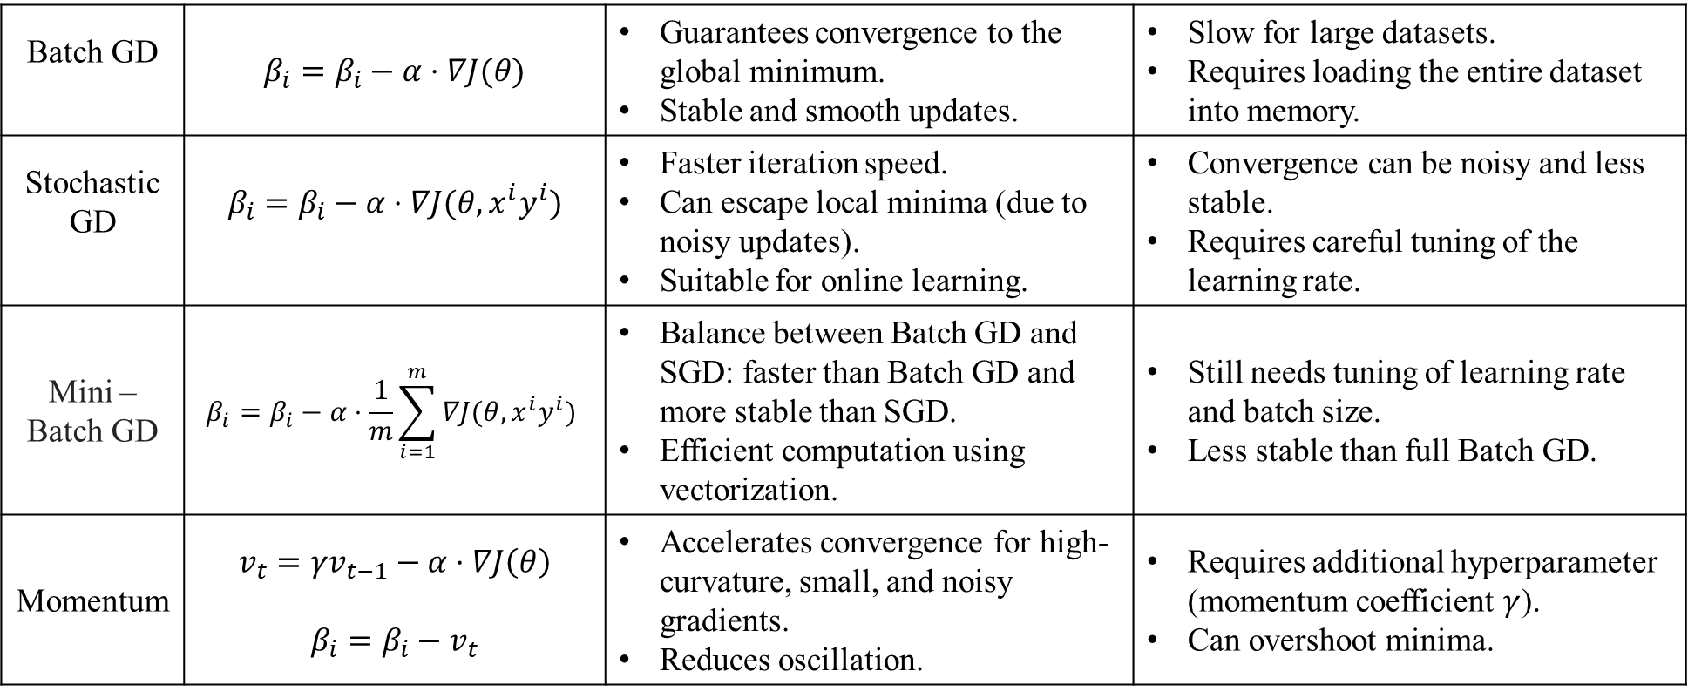
Optimizers
Batch GD | $$β_{i}=β_{i}−α⋅∇J(θ)$$ | Guarantees convergence to the global minimum. Stable and smooth updates. | Slow for large datasets. Requires loading the entire dataset into memory.
Stochastic GD | $$β_{i}=β_{i}−α⋅∇J(θ, x^{i}y^{i})$$ | Faster iteration speed. Can escape local minima (due to noisy updates). Suitable for online learning. | Convergence can be noisy and less stable. Requires careful tuning of the learning rate.
Mini – Batch GD | $$β_{i}=β_{i}−α⋅\frac{1}{m}\sum_{i=1}^{m}{∇J(θ, x^{i}y^{i}) }$$ | Balance between Batch GD and SGD: faster than Batch GD and more stable than SGD. Efficient computation using vectorization. | Still needs tuning of learning rate and batch size. Less stable than full Batch GD.
Momentum | $$v_{t}={γv}_{t−1}−α⋅∇J\left(θ\right)$$ $$β_{i}=β_{i}−v_{t}$$ | Accelerates convergence for high-curvature, small, and noisy gradients. Reduces oscillation. | Requires additional hyperparameter (momentum coefficient $γ$). Can overshoot minima.
Notes:
Batch GD
Updates all parameters by computing the gradient over the entire dataset in one go. It can be slow for large datasets but guarantees convergence for convex problems.
Stochastic GD
Unlike Batch Gradient Descent, SGD updates parameters for each training example one at a time, making it faster and more suitable for large datasets, but with noisier convergence.
Mini – Batch GD
Combines the benefits of Batch and SGD by updating parameters based on a small random subset of the data (mini-batch), leading to faster and more stable convergence.
Momentum
$v_{t}$Velocity, which accumulates the gradient's past values. (Initial Value is generally zero)
$γ$ Momentum coefficient (typically between 0.5 and 0.9).
Adds a fraction of the previous update to the current update, helping to accelerate convergence and reduce oscillations, especially in ravines.

Slide 28
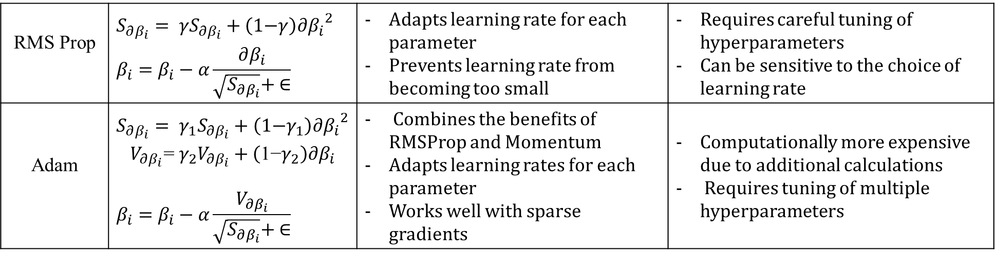
Optimizers
RMS Prop | $$S_{∂β_{i}}= {γS}_{∂β_{i}}+\left(\text{1−}γ\right){∂β_{i}}^{2}$$ $$β_{i}=β_{i}−α\frac{∂β_{i}}{\sqrt{S_{∂β_{i}}}+ ∈}$$ | Adapts learning rate for each parameter Prevents learning rate from becoming too small | Requires careful tuning of hyperparameters Can be sensitive to the choice of learning rate
Adam | $$S_{∂β_{i}}= {γ_{1}S}_{∂β_{i}}+\left(\text{1−}γ_{1}\right){∂β_{i}}^{2}$$ $$V_{∂β_{i}}\text{= }{γ_{2}V}_{∂β_{i}}+\left(\text{1−}γ_{2}\right)∂β_{i}$$ $$β_{i}=β_{i}−α\frac{V_{∂β_{i}}}{\sqrt{S_{∂β_{i}}}+ ∈}$$ | Combines the benefits of RMSProp and Momentum Adapts learning rates for each parameter Works well with sparse gradients | Computationally more expensive due to additional calculations Requires tuning of multiple hyperparameters
Notes:
Batch GD
Updates all parameters by computing the gradient over the entire dataset in one go. It can be slow for large datasets but guarantees convergence for convex problems.
Stochastic GD
Unlike Batch Gradient Descent, SGD updates parameters for each training example one at a time, making it faster and more suitable for large datasets, but with noisier convergence.
Mini – Batch GD
Combines the benefits of Batch and SGD by updating parameters based on a small random subset of the data (mini-batch), leading to faster and more stable convergence.
Momentum
$v_{t}$Velocity, which accumulates the gradient's past values. (Initial Value is generally zero)
$γ$ Momentum coefficient (typically between 0.5 and 0.9).
Adds a fraction of the previous update to the current update, helping to accelerate convergence and reduce oscillations, especially in ravines.

Slide 29
How to try Hyperparameters
First focus on Most important ones and then the lesser ones in the sequence
Learning Rate
Hidden units
Mini batch size
Beta
Number of Layers
Learning Decay Rate
Others

Slide 30
Thank You

